Slide 1


Dijkstra’s shortest path algorithm
Greg Duffley
Warren Peterson
CST-201 1/15/2022
Notes:
Slide Created by Greg Duffley & Warren Peterson on 1/15/2022

Slide 2
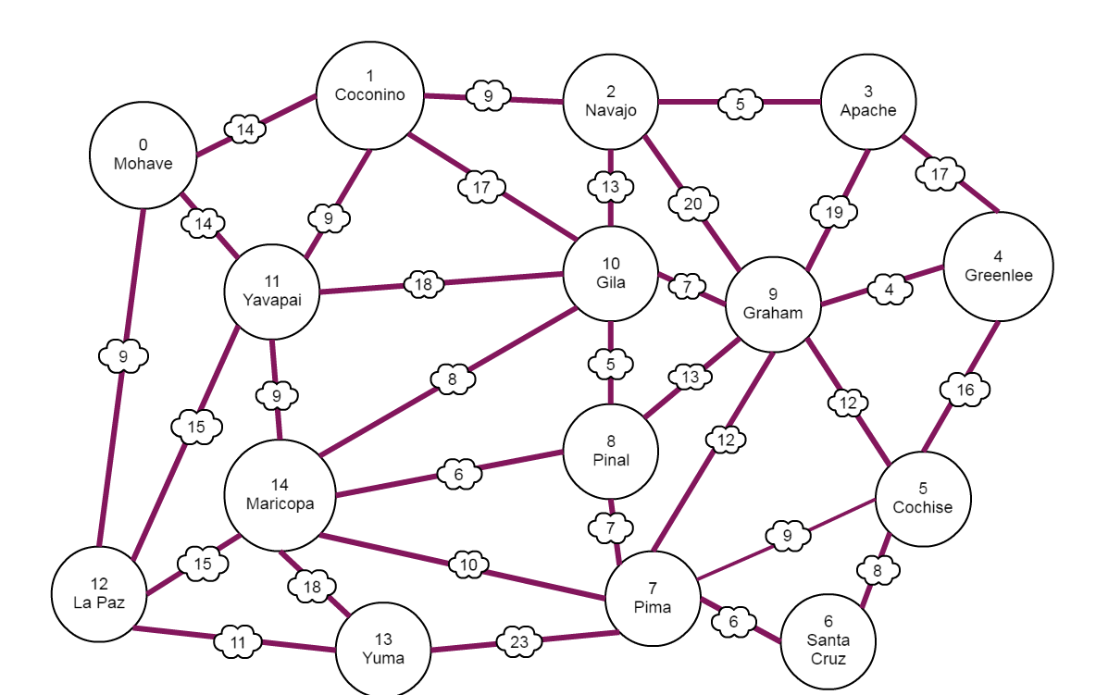
Shortest Path
Test Program to find shortest
Path between any two vertices
Coconino(1) & Santa Cruz(6) = 35
Greenlee(4) & La Paz(12) = 34
Apache(3) & Yuma(13) = 44
Cochise(5) & Yavapai(11) = 28
Notes:
Slide Created by Warren Peterson on 1/15/2022

Slide 3
Shortest Path
int shortestPath(int graph[SIZE][SIZE], int src, int end) {
int distance[SIZE];
bool shortestPathTreeSet[SIZE];
for (int i = 0; i < SIZE; i++) {
distance[i] = INT_MAX, shortestPathTreeSet[i] = false;
}
dist[src] = 0;
for (int count = 0; count < SIZE – 1; i++) {
int u = minDistance(distance, shortestPathTreeSet);
shortestPathTreeSet[u] = true;
for (int value = 0; value < SIZE; value++) {
if (!shortestPathTreeSet[value] && graph[u][value] && distance[u] != INT_MAX && distance[u] + graph[u][value] < distance[value]) {
distance[value] = distance[u] + graph[u][value];
}
}
}
return distance[end];
}
Notes:
Slide Created by Greg Duffley & Warren Peterson on 1/15/2022

Slide 4
Min Distance for Shortest Path
int minDistance(int dist[], bool sptSet[] ) {
int min = INT_MAX, min_index;
for ( int value = 0; value < SIZE; value++) {
if ( !sptSet[value] && dist[value] <= min) {
min = dist[i];
min_index = value;
}
}
return min_index;
{
Notes:
Slide Created by Greg Duffley & Warren Peterson on 1/15/2022

Slide 5
Steps of the Algorithm
Let the node at which we are starting be called the initial node. Let the distance of node Y be the distance from the initial node to Y. Dijkstra's algorithm will initially start with infinite distances and will try to improve them step by step.
Mark all nodes unvisited
Assign to every node a tentative distance value
For the current node, consider all of its unvisited neighbors and calculate their tentative distances through the current node.When we are done considering all of the unvisited neighbors of the current node, mark the current node as visited and remove it from the unvisited set. A visited node will never be checked again.
If the destination node has been marked visited (when planning a route between two specific nodes) or if the smallest tentative distance among the nodes in the unvisited set is infinity then stop. The algorithm has finished.
Otherwise, select the unvisited node that is marked with the smallest tentative distance, set it as the new current node, and go back to step 3.
Notes:
Slide Created by Greg Duffley & Warren Peterson on 1/15/2022

Slide 6
Steps of the Algorithm
Time complexity is O(ElogV)
V is the number of vertices
E is the total number of edges
Time Complexity can vary by the data structure used
Can be O(V^2) if an array is used
Notes:
Slide Created by Greg Duffley & Warren Peterson on 1/15/2022

Slide 7
Work Cited
Dijkstra's algorithm for adjacency list representation: Greedy Algo-8. GeeksforGeeks. (2021, November 24). Retrieved January 16, 2022, from https://www.geeksforgeeks.org/dijkstras-algorithm-for-adjacency-list-representation-greedy-algo-8/
Wikimedia Foundation. (2022, January 9). Dijkstra's algorithm. Wikipedia. Retrieved January 16, 2022, from https://en.wikipedia.org/wiki/Dijkstra%27s_algorithm
Notes:
Slide Created by Greg Duffley & Warren Peterson on 1/15/2022

